Slide 1


Slide 2


Slide 3


Slide 4


Slide 5
OUR PRAYER LIFE?

Slide 6
OUR PRAYER LIFE?
PLEASE PRAYERS

Slide 7
OUR PRAYER LIFE?
PLEASE PRAYERS
THANK YOU PRAYERS

Slide 8
OUR PRAYER LIFE?
SORRY PRAYERS
PLEASE PRAYERS
THANK YOU PRAYERS

Slide 9
OUR PRAYER LIFE?
HONEST PRAYERS
SORRY PRAYERS
PLEASE PRAYERS
THANK YOU PRAYERS

Slide 10
OUR PRAYER LIFE?
WHERE ARE
PRAYERS OF
PRAISE?

Slide 11
OUR PRAYER LIFE?
WHERE ARE
PRAYERS OF
PRAISE?
Life is too hard?

Slide 12
OUR PRAYER LIFE?
WHERE ARE
PRAYERS OF
PRAISE?
Life is too hard?
Life is too busy?

Slide 13
OUR PRAYER LIFE?
WHERE ARE
PRAYERS OF
PRAISE?
Life is too hard?
Life is too busy?
Our knowledge is lacking?

Slide 14
OUR PRAYER LIFE?
WHERE ARE
PRAYERS OF
PRAISE?
Life is too hard?
Life is too busy?
Our knowledge is lacking?
Our experience is lacking?

Slide 15
WHY PRAISE SHOULD BE PART OF OUR PRAYERS

Slide 16
WHY PRAISE SHOULD BE PART OF OUR PRAYERS
“Great is the Lord and most worthy of praise,
his greatness no one can fathom”
[v.3]

Slide 17
WHY PRAISE SHOULD BE PART OF OUR PRAYERS
“Great is the Lord and most worthy of praise,
his greatness no one can fathom”
[v.3]

Slide 18
WHY PRAISE SHOULD BE PART OF OUR PRAYERS
“Great is the Lord and most worthy of praise,
his greatness no one can fathom”
[v.3]

Slide 19
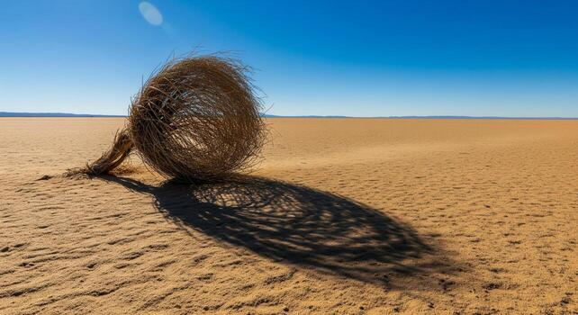

Slide 20
Day and night they never stop saying “Holy, Holy, Holy, is the Lord God almighty who was an is and is to come… they sing worthy is the lamb who was slain to receive honour and glory and praise
Revelation 4:8. 5:12

Slide 21
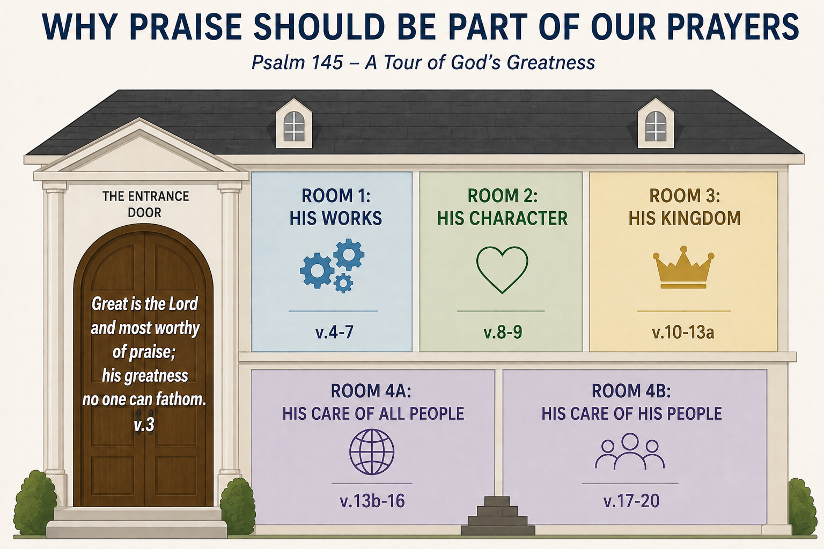

Slide 27
HOW PRAISE COULD BE PART OF OUR PRAYERS

Slide 28
HOW PRAISE COULD BE PART OF OUR PRAYERS
Be deliberate

Slide 29
HOW PRAISE COULD BE PART OF OUR PRAYERS
Be deliberate
I will exalt you, my God the King; I will praise your name for ever and ever. Every day I will praise you and extol your name for ever and ever [v.1-2]

Slide 30
HOW PRAISE COULD BE PART OF OUR PRAYERS
Be deliberate
I will exalt you, my God the King; I will praise your name for ever and ever. Every day I will praise you and extol your name for ever and ever [v.1-2]
My mouth will speak in praise of the Lord… [v.21]

Slide 31
HOW PRAISE COULD BE PART OF OUR PRAYERS
Be deliberate
Be dependent

Slide 32
HOW PRAISE COULD BE PART OF OUR PRAYERS
Be deliberate
Be dependent
Be declarers

Slide 33
Our mouths will speak in praise of the Lord
Let every creature praise his holy name for ever and ever
Psalm 145:21

